Slide 1
Applying Machine Learning to cardiology: Predicting coronary Heart disease
D. Alex Lou

Slide 2
What is Coronary Heart Disease (CHD)?
CHD tends to develop when cholesterol builds up on the artery walls, creating plaques. These plaques cause the arteries to narrow, reducing blood flow to the heart. A clot can sometimes obstruct the blood flow, causing serious health problems.
About 610,000 people die of heart disease in the United States every year–that’s 1 in every 4 deaths.
CHD is the most common type of heart disease, killing over 370,000 people annually in the U.S.

Slide 3

How do we currently diagnose Chd?
Your doctor can determine your risk for CHD by checking the following:
He or she may check your cholesterol levels and blood pressure.
Your doctor also will want to know about your lifestyle and family history

Slide 4

How do we currently diagnose Chd?
Electrocardiogram (ECG or EKG)
Echocardiogram (ECG)
Chest X-ray
Exercise stress test
Coronary angiogram
Cardiac catheterization
Cardiac computed tomography (CT) scan
Notes:
Electrocardiogram (ECG or EKG)measures the rhythm, speed, and evenness of your heartbeat.
Echocardiogram (ECG)produces an image of your heart using ultrasound.
Chest X-ray produces an image of your heart and chest area using radiation.
Exercise stress test checks your heart rate during activity.
Coronary angiogram checks your arteries for flow and blockage. This test uses injected dye to take X-rays and monitor blood flow.
Cardiac catheterization checks your arteries for flow and blockage. A catheter (thin tube) goes into your arteries from your groin, arm, or neck.
Cardiac computed tomography (CT) scan produces an image of your heart and arteries. This test uses radiation and contrast dye.

Slide 5
How can Machine Learning help?
Additional first stage diagnostic tool
Able to factor in other complex phenomena

Slide 6
Data - Framingham study
Target Variable:
10 Year Coronary Heart Disease
Features:
Gender, Age, Current Smoker, Cigarettes Per Day, BP Meds, Prevalent Stroke, Prevalent Hypertension, Diabetes, Total Cholesterol, Systolic BP, Diastolic BP, BMI, Resting Heart Rate, Glucose, Education

Slide 7
How do we measure a model’s success?
Ideal world:
Correctly predict the CHD for patients that actually developed CHD
Which misprediction is more costly?

Slide 8
How do we measure a model’s success?
Ideal world:
Correctly predict the CHD for patients that actually developed CHD
Which misprediction is more costly?
Predicting no CHD when in actuality you are at high risk

Slide 9
Logistic Regression Model
Test Set:
Data the model has never seen
Predicted 64% of patients that actually developed CHD.
 | No CHD (Predicted) | CHD (Predicted)
No CHD (Actual) | 403 | 174
CHD (Actual) | 37 | 65

Slide 10
Logistic Regression Model
Me
Unhealthy me in the future
Male
25 years old
Non-smoker
132/87 BP
21.9 BMI
Likelihood of developing 10 year CHD?

Slide 11
Logistic Regression Model
Me
Unhealthy me in the future
Male
25 years old
Non-smoker
132/87 BP
21.9 BMI
Likelihood of developing 10 year CHD?
8%

Slide 12
Logistic Regression Model
Me
Unhealthy me in the future
Male
25 years old
Non-smoker
132/87 BP
21.9 BMI
Male
40 years old
Smoker (pack a day)
Obese
Likelihood of developing 10 year CHD?
8%

Slide 13
Logistic Regression Model
Me
Unhealthy me in the future
Male
25 years old
Non-smoker
132/87 BP
21.9 BMI
Male
40 years old
Smoker (pack a day)
Obese
Likelihood of developing 10 year CHD?
8%
76%

Slide 14
Conclusion
Doctors can benefit from including a machine learning classification model as part of the first stage of diagnosis for CHD
Classification model should be tuned to maximize recall for patients that are high risk for CHD (ie minimize false negative predictions)

Slide 15
Thank you
D. Alex Lou
d.alexlou17@gmail.com
alexlou.squarespace.com

Slide 16
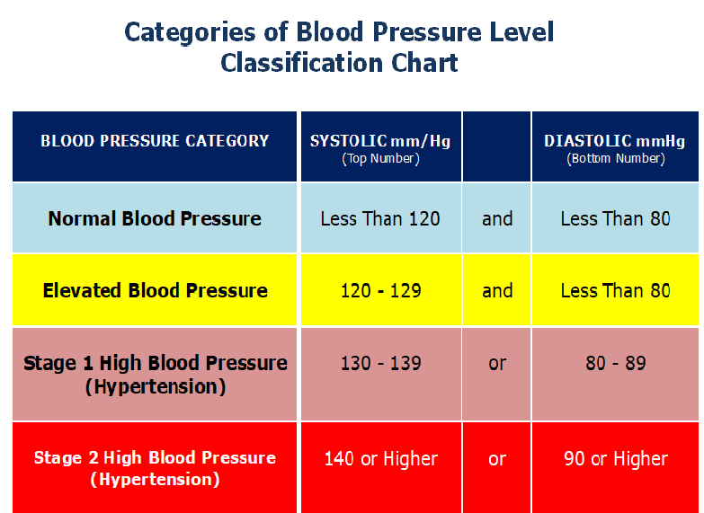
Appendix
This Photo by Unknown Author is licensed under CC BY-SA

Slide 17
Appendix

Slide 18
Appendix - Major Risk Factors
Key Factors
High blood pressure
High LDL cholesterol
Smoking
Additional Factors
Diabetes
Overweight and obesity
Source: CDC

Slide 19
Appendix - CHD Risk Factors
Key Factors
High blood pressure
High LDL cholesterol
Smoking
Additional Factors
Diabetes
Overweight and obesity
49% of American have at least 1 of these key factors
Source: CDC

Slide 20
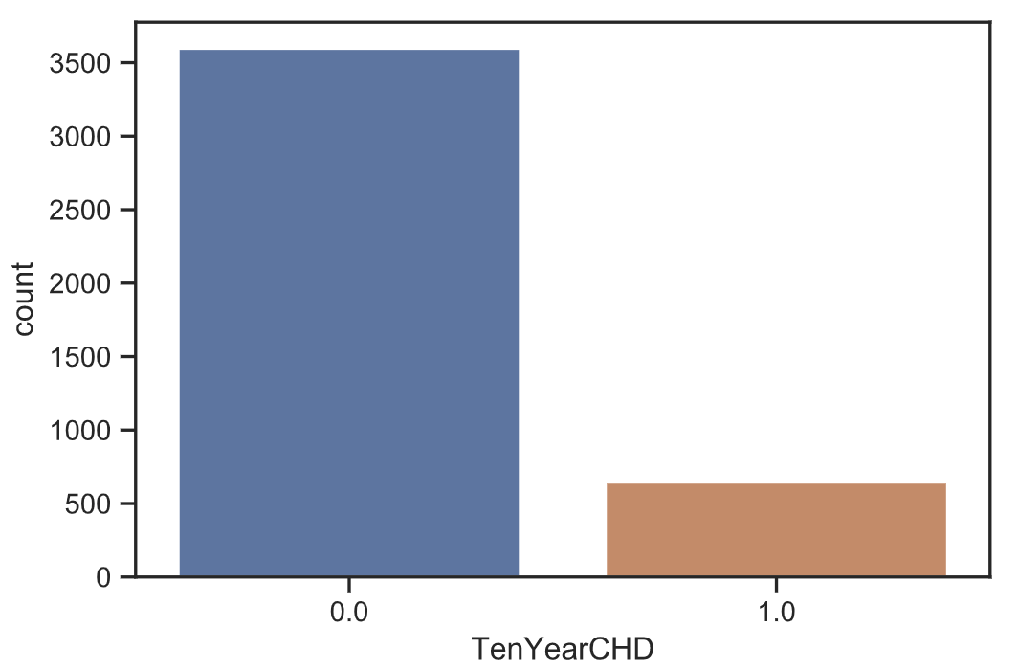
Appendix

Slide 21
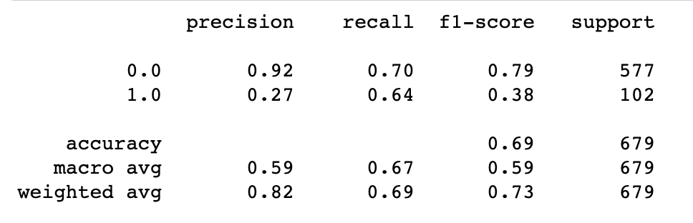
Appendix
Logistic Regression Metrics

Slide 22
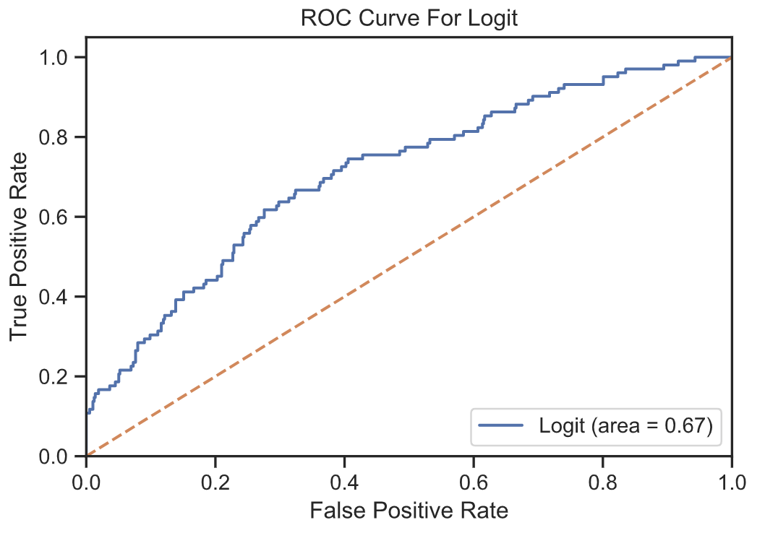
Appendix

